Slide 1
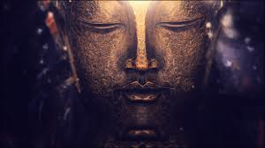
Attention and Heroism

Slide 2
“Our human compassion binds us the one to the other - not in pity or patronizingly, but as human beings who have learnt how to turn our common suffering into hope for the future.”
Nelson Mandela

Slide 3
Wisdom and Uncertainty

Slide 4
Compassion Defined
“a basic kindness, with deep awareness of the suffering of oneself and of other living things, coupled with the wish and effort to relieve it.” (Gilbert, 2009)

Slide 5
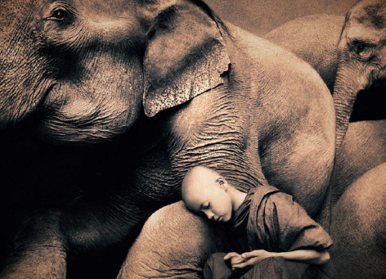
Compassion Defined
Compassion has evolved from “the caregiver mentality” found in human parental care and childrearing.

Slide 6
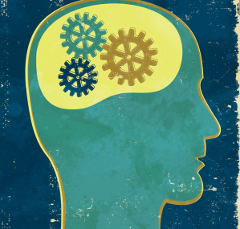
Compassion Defined
Compassion in therapy links -
“psychotherapeutic processes with evolved psychological systems, especially those associated with social behavior” (Gilbert, 2007)

Slide 7
Compassion and Evolution
Compassion is linked to the activation of affiliative emotions.
Attachment bonds form a ‘secure base’ for operation in the world.
Involves‘species-preservative’ perspective as opposed to that of a ‘self-preservative’ system. (Wang, 2005)

Slide 8
Compassion and Evolution
emering from from the critical role of care-giving and parenting
This invovles the development of an enlarged neocortex (Wang, 2005)

Slide 9
Perspectives on Compassion
Ancient wisdom
Compassion transforms the mind. (Buddhism)
Evolution
Evolution has made our brains highly sensitive to internal and external kindness
Neuroscience
Specific brain areas are focused on detecting and responding to kindness and compassion
ACT
Compassion is a value inherent in psychological flexibility model –
Self-compassion related to flexible perspective taking

Slide 10
The path of compassion is not a
“soft option” – it involves cultivating
Wisdom
Strength
Commitment
. . .and Courage

Slide 11
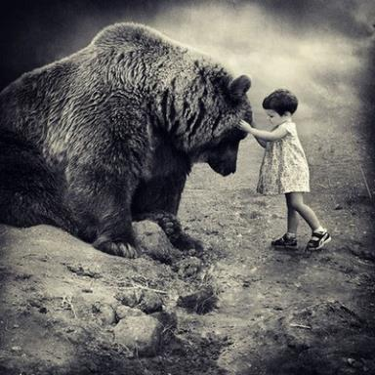
Courage
The mental or moral strength to venture, persevere and withstand danger fear or difficulty
The ability to so something that you know is difficult or dangerous

Slide 12
Courage
Because of great love one is courageous
Being deeply loved gives you strength. Loving someone deeply gives you courage – Lao Tzu

Slide 14
"I learned that courage was not the absence of fear, but the triumph over it. The brave man is not he who does not feel afraid, but he who conquers that fear.”
Nelson Mandela

Slide 15
The Two Psychologies of Compassion
Compassion “As a sensitivity to the suffering of self and others with a deep commitment to try to relieve it and prevent it”,
Two different aspects of compassion:
To approach, understand and (how to) engage with suffering
To work to alleviate and prevent suffering

Slide 16
Compassionate Process
Mindful Compassionate Engagement
Motivation, sensitivity, sympathy, distress tolerance, empathy nonjudgement/acceptance
Wisdom
Courage
Mindful Compassionate Alleviation
Motivation, attention, thinking, behaviour, feeling, imagery, sensory focusing
Build compassionate capacity for engaging and changing

Slide 17
Compassion from a CBS perspective
Dahl, Plumb, Stewart and Lundgren, (2009)
Self-Compassion involves:
willingly experiencing difficult emotions;
mindfully observing our self-evaluative, distressing and shaming thoughts without allowing them to dominate our behavior or our states of mind
engaging more fully in our life’s pursuits with self-kindness and self-validation
flexibly shifting our perspective towards a broader, transcendent sense of self (Hayes, 2008a).

Slide 18
Compassion from a CBS perspective
Our learned capacity for flexible perspective taking is involved in our experience of empathy (Vilardaga, 2009), as well as our related experience of compassion.
In order to understand self-compassion, therefore, it’s useful to consider the “self” that is the focus of compassion, from an RFT perspective.

Slide 19
Compassion from a CBS perspective
Deictic relations are building blocks of how we experience the world, ourselves, and the flow of time.
Returning to an awareness of self-as-context offers us a non-attached and dis-identified relationship to our experiences.
This allows the habitual stimulus functions of our painful private events and stories to hold less influence over us.

Slide 20
Compassion from a CBS perspective
From the perspective of the I-Here-Nowness of being, I can view my own suffering as I might view the suffering of another, and be touched by the pain in that experience, without the dominant interference of my verbal learning history, with its potential for shaming self-evaluations (Vilardaga, 2009; Hayes, 2008).

Slide 21
Formation of Self-as-Context: The No-Thing Self (Hayes, 2008)
YOU
HERE
NOW
I
THERE
THEN

Slide 22
I-Here-Nowness of Perspective Taking
Self-as-context

Slide 23
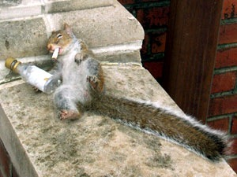
Why do we need Compassion?
Life is Hard

Slide 24
Compassion begins with a reality check
We come out of the world,
not into it. - Watts
We are an emergent species in the ‘flow of life’ so our brains, with their motives, emotions, and response patterns are products of evolution, designed to function in certain ways

Slide 25
Compassion begins with a reality check
We are designed for wanting, craving needing and seeking permanence – to fear and aggress, to love and to grieve – to know of our destiny.
We move towards what might sustain and benefit us (appetitive stimuli) and away from that which may harm us (aversive stimuli).

Slide 26
Compassion begins with a reality check
We are an emergent species in the ‘flow of life’ so our brains, with their motives, emotions and competencies are products of evolution, designed to function in certain ways
Our lives are short (25,000-30,000 days), decay and end. We are subject to various malfunctions and diseases – in a genetic lottery. Everything changes – the nature of impermanence – the nature of tragedy
The social circumstances of our lives, over which we have no control, have major implications for the kinds of minds we have, the kind of person we become, the values we endorse, and the lives we live

Slide 27
So, Basic Philosophy is That:
We all just find ourselves here with a brain, emotions and sense of (socially made) self we did not choose but have to figure out
Life involves dealing with tragedies (threats, losses, diseases, decay, death) and people do the best they can
Much of what goes on in our minds is not of ‘our design’ and not our fault
We are all in the same boat
De-pathologising and de-labelling – understanding unique coping processes

Slide 28
Causes of Suffering
The Evolutionary Context
Evolved Response Systems
Evolutionary functionary analysis
Learning History
Genotype and phenotype
Social history
Functional Analysis
The Present Moment Context
Mindfulness/Sleepfulness
Compassion/Threatened Mind
Flexibility/Inflexibility

Slide 29
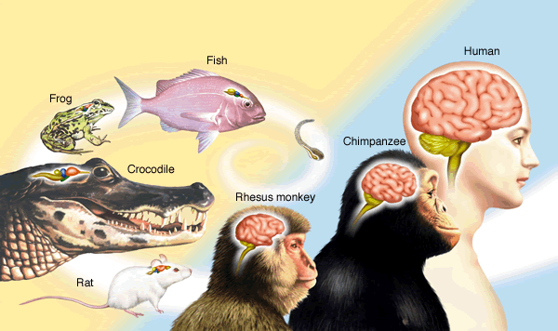
The human brain is the product of many millions of years of evolution – a process of conserving, modifying and adapting

Slide 30
New Psychologies Emerge in the World
1 million? Extended caring
Human Symbolic thought and
(2 million?) self-identity, theory of mind, meta-cognition
Mammalian Caring, group, alliance-
(120 million?) building, play, status
Reptilian Territory, fear, aggression,
(500 million?) sex, hunting

Slide 31
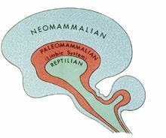
Brain Development in Deep Historical Context

Slide 32
Private Events and Brain Development in the context of Genotype, Phenotype, and Present Moment
1. “Old Brain”
Emotional Responding: Anger, anxiety, sadness, joy, lust
Overt Behavioral Responding: Fight, flight, withdraw, engage
Relationship Behaviors: Sex, status, attachment, tribalism
2. “New Brain”
Relational Framing, Imagination, fantasize, look back and forward, plan,
Integration of mental abilities
Self-awareness, self-identity, flexible perspective taking, self- feeling
3. “Social Brain”
Need for affection and care
Socially responsive, self-experience and motives
?

Slide 33
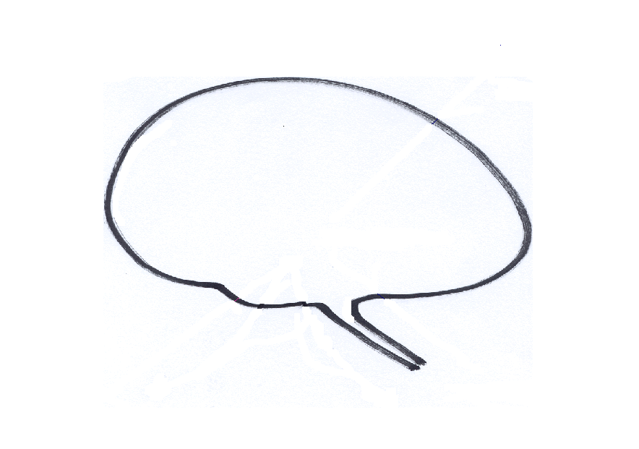
Sources of behaviour
Need compassion for a very tricky brain
New Brain: Imagination,
Planning, Rumination, Integration
Old Brain: Emotions, Motives, Relationship Seeking-Creating

Slide 34
Mind Problems: Our Built in Biases
Biased learning – e.g., fear of snakes not electricity
Biases can be implicit (non-conscious) or explicit (Conscious)
Self-focused
Kin preferences – (nepotism)
In-group preferences – (tribalism)

Slide 35
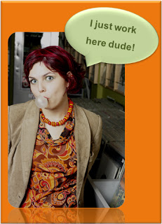
Mind Problems: Our Built in Biases

Slide 36
Attention and Behavior

Slide 37
Mind Problems: “Thinky Pain”
Derived Relational Responding
Fusion
Avoidance, Control and Suppression

Slide 38
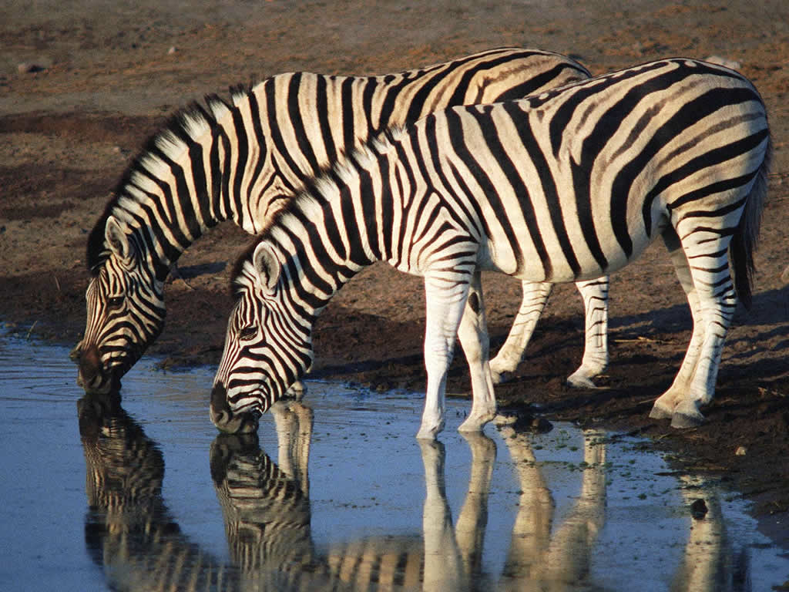
Mind Problems: “Thinky Pain”

Slide 39
How our own thoughts and images affect our brains
Sexual
Bully-threat
Meal
Meal
Sex
Bully- threat
Kind, warm and caring
Emotion Brain
Compassion
Soothed
Safe
Stomach acid
Salvia
Fearful
Depressed
Arousal
Pink represents our inner images and thoughts

Slide 40
Sources of behaviour
Interaction of old and new psychologies
New Brain:
Derived Relational Responding, Selfing
Planning, Rumination,
Old Brain: Emotions, Motives, Relationship Seeking, Safety Seeking Behaviors

Slide 41
Sources of behaviour
Need compassion for a very tricky brain
Mindful Brain
New Brain: Imagination,
Planning, Rumination, Integration
Old Brain: Emotions, Motives, Relationship Seeking-Creating
COMPASSION

Slide 42
Sources of behaviour
Need compassion for a very tricky brain
Mindful Brain
New Brain: Imagination,
Planning, Rumination, Integration
Old Brain: Emotions, Motives, Relationship Seeking-Creating
COMPASSION

Slide 43
Sources of behaviour
Need compassion for a very tricky brain
Mindful Brain
New Brain: Imagination,
Planning, Rumination, Integration
Old Brain: Emotions, Motives, Relationship Seeking-Creating
Competitive

Slide 44
Understanding our Motives and Emotions
Motives and their social mentalities evolved because they help animals to survive and leave genes behind
Emotions guide us to our (social) goals, respond if we are succeeding or threatened
There are three types of emotion regulation
Those that focus on threat and self-protection
Those that focus on doing and achieving
Those that focus on contentment and feeling safe

Slide 45
Types of Affect Regulator Systems
Drive, excite, vitality
Content, safe, connected
Non-wanting/
Affiliative focused
Safeness-kindness
Soothing
Incentive/resource- focused
Wanting, pursuing, achieving, consuming
Activating
Threat-focused
Protection and
Safety-seeking
Activating/inhibiting
Anger, anxiety, disgust

Slide 46
Between self and others
Self to self
Calms
Affiliative/ Soothing
Threat
120 Million year evolving system to regulate threat

Slide 47
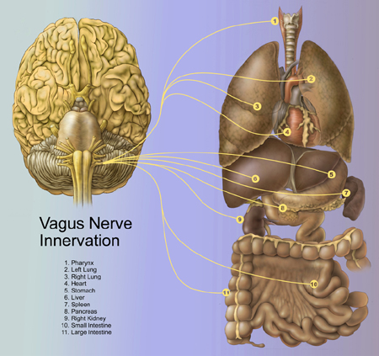
Safeness -connecting and the parasympathetic system: The Vagus Nerve
PNS influence on heart rate – slows beat down during outbreath
Associated with affiliation, tend & befriend, general positive emotional tone
Sensitive to safeness
Notes:
Emanating from the brainstem, the 10th cranial nerve, is the Vagus. The Vagus is affectionately referred to as the ‘wandering’ nerve – because it projects to so many parts of the body and is involved in a range of functions, as depicted by the yellow lines here. The Vagus nerve functions I would like to focus on – which have to do with mindfulness at the 2 and 3 levels, are it’s influence on heart rate, and it’s role in affiliative states. The yellow line that terminates on a number 4 – represents a shockingly important process – the Vagus nerve imparting parasympathetic influence on heart rate – that is – slowing the heart down. Without vagal input, your heart would beat unsustainably fast to your mortal demise. There is a rich scientific literature on this process, measuring the ratio of heart rate during inhale (driven by sympathetic input) and that during exhale (vagal input) – yielding a measure called Vagal Tone. Vagal Tone, it turns out, is predictive of a host of benefits: calm behavioral states, being better at relating to emotional experiences in a healthy way (a property often called resilience), generally experiencing more positive than negative emotional states, lower blood pressure, and more. Mindfulness practice has been shown to strengthen vagal tone (Ditto, McGill, Annals of Behavioral Medicine). That said, thinking about mindfulness & compassion, the capacity of vagal tone to adapt to environmental changes (e.g., physiological, cognitive or psychological challenges) defined as vagal flexibility, e.g. high vagal flexibility allows sympathetic activity to occur and limits efficiently the stress period to the stressors presence may be the measure of importance. Studies have shown that vagal recovery may be more strongly associated with mindfulness than vagal tone alone.
The second function I’d like to touch upon comes from a pioneering scientist named Steve Porges, author of the PolyVagal theory – which suggest that a primary funciton of the Vagus nerve is to support affiliation and the formation of social ties that lead to long term relationships. Coming from a functional biological perspective, Porges suggests that the Vagus nerve’s visceral input to the brain, support of vocal fluctuations and parasympathetic influence drives people to approach others for cooperative gain, to communicate in close proximity, and develop dependencies. An entire field has emerged from Porges’s – including work by Dacher, Stepahie Brown, and others. A key part of the story here is that vagal influence is exxentially silenced by fear, vigilance to threat, anxiety, etc…
An emerging science on the study of MindWandering – that is – absentmindedly thinking about what’s not happening right now – is deleterious to happiness – engages systems that typically track thoughts about the self: what happened, what might happen, and why they might not like me…a style of reflexive thinking for which mindfulness is pointedly an antidote.

Slide 48
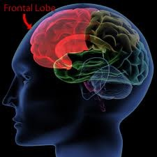
‘New Brain’ with Frontal cortex and PNS
HRV ass. with flexibility
Mindful attention
Control of attention
Reflective thinking
Empathy – mentalizing
Not acting on emotions

Slide 49
‘Some Overloads for New brain
Chronic sympathetic arousal
Rapid shifts of attention
No time for reflective thinking
Fear based (personal distress) based arousal
Self-criticism and self-doubt
Systemic failures in support

Slide 50
Attachment
Proximity seeking –desire closeness, to be with
Safe base –source of security to go out and explore and develop confidence
Safe haven –source of conflict comment and emotion regulation
Social signals are the drivers (social mentality)

Slide 51
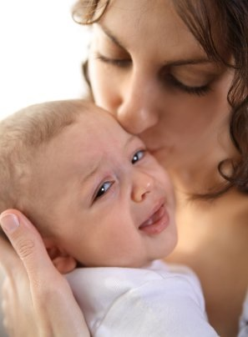

Slide 53
Functions of Caring-Attachments - Needs Sensitivity
The Carer-Provider offers…
Protection: anticipating/preventing; build nest out of harms way, defending/standing up for – advocate
Distress call responsive: listening out for; rescuing; coming to the aid of – responding to distress
Provision: physical care, hygiene, food,
Affection: warmth positive affects that acts as key inputs for brain maturation
Education and Validation: teach/learn life skills in family context: understanding one’s own mind
Interaction: being present, stimulating and regulating various affect systems: curiosity, play, soothing – socialising agent – shaping phenotypes

Slide 54
Internal Threat and Soothing
Self-affiliation – experiences a lovable self
Calms
Affiliative/ Soothing
Threat
Internal representations of helpful others and sources of comfort
Neurophysiological networks
Emotional memories of soothing

Slide 55
Functional Safeness
Supports relationship building and pro-social behaviour
Calms
Affiliative/ Soothing
Threat
Can regulate threat via access to others and later internal soothing
Develop mentalizing and empathy skills
Safe to explore and have open attention – development of (social) intelligence

Slide 56
Internal Threat and More threat
No self-affiliation – experiences a unlovable self
Calms
Affiliative/ Soothing
Threat
Others are threats or alarming
Neurophysiological networks
Emotional memories of no soothing

Slide 57
Compassion Process
Giving/doing
Mindful Acts of kindness
Engagement with the feared
Receiving/soothing
SBR/booth
Validation
Gratitude appreciation
Compassionate Self
Threat
Mindful awareness
Triggers
In the body
Rumination
Labelling

Slide 58
Caring-Compassionate Mind
Warmth
Warmth
ATTRIBUTES
Sensitivity
Sympathy
Compassion
Distress tolerance
Care for well-being
Non-Judgement
Empathy
Warmth
Warmth

Slide 59
Compassionate Mind - Alleviation
SKILLS -TRAINING
Warmth
Warmth
Imagery
Attention
ATTRIBUTES
Reasoning
Sensitivity
Sympathy
Compassion
Distress tolerance
Care for well-being
Feeling
Empathy
Behaviour
Non-Judgement
Sensory
Warmth
Warmth

Slide 60
Key Targets of Therapy
Thinking
Reasoning
Attention
Imagery Fantasy
Behaviour
Motivation
Emotions
Their pattern gives rise to a certain type of mind

Slide 61
Compassionate Mind
Thinking
Reasoning
Attention
Imagery Fantasy
Compassion
Behaviour
Motivation
Emotions

Slide 62
Threatened Mind can block Compassion
Thinking
Reasoning
Attention
Imagery Fantasy
Threat
Behaviour
Motivation
Emotions

Slide 63
Self-Critical Mind is also Threat-focused Mind
Thinking
Reasoning
Attention
Imagery Fantasy
Self-
Critical
Behaviour
Motivation
Emotions

Slide 64
Compassionate Mind
Thinking
Reasoning
Attention
Imagery Fantasy
Compassion
Behaviour
Motivation
Emotions

Slide 65
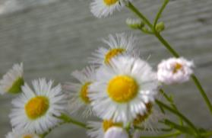
Psychological Flexibility
“In this very moment, will you accept the sad and the sweet, hold lightly stories about what’s possible, and be the author of a life that has meaning and purpose for you, turning in kindness back to that life when you find yourself moving away from it?”
(Wilson, 2010)

Slide 66
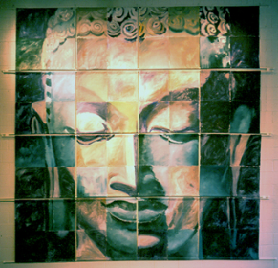
Psychological Flexibility
“It is defined as the ability to fully contact the present moment and the thoughts and feelings it contains without needless defense, and, depending upon what the situation affords, persisting or changing in behavior in the pursuit of goals and values.” (Hayes, et. al., 2006)

Slide 67
Psychological Flexibility
Present Moment Contact
Values Authorship
Willingness
Psychological Flexibility
Defusion
Commitment
Self-As-Context

Slide 68
Psychological Flexibility
Increasing psychological flexibility involves helping clients to disentangle themselves from the cycle of experiential avoidance and cognitive fusion, not by challenging or changing their thoughts and emotions for example, but by learning to react more mindfully to such experiences, so that they no longer seem to be barriers (Ciarrochi, et al., 2006).

Slide 69
Examples of Psychological Flexibility’s Importance
In more than 40 studies with nearly 10,000 participants, psychological flexibility accounts for 16 to 33% of most psychological outcomes
There is evidence that the effects of negative thoughts, difficult feelings, maladaptive coping, emotional response styles, cognitive reappraisal, and perceived controllability, are all partially or fully mediated by psychological flexibility (Hayes, 2008)

Slide 70
Compassionate Flexibility
The ability to contact the present moment fully, as a conscious and emotionally responsive human being with:
Sensitivity to the presence of suffering in oneself and others
Motivation to alleviate and prevent human suffering in oneself and others

Slide 71
Compassionate Flexibility
The ability to contact the present moment fully, as a conscious and emotionally responsive human being with:
Persistent adaptation to competing and changing environmental, emotional, and motivational demands and returning attention and resources to the alleviation and prevention of suffering in oneself and others

Slide 72
Compassionate Flexibility
The ability to contact the present moment fully, as a conscious and emotionally responsive human being with:
The ability to flexibly shift perspective and access a broader sense of oneself and others, involving the experience of empathy and sympathy
The ability to disentangle oneself from the excessive influence of evaluative, judgmental thoughts.

Slide 73
Compassionate Flexibility
The ability to contact the present moment fully, as a conscious and emotionally responsive human being with:
Maintaining an open and noncondemning perspective on human experience itself, thereby cultivating necessary and sufficient willingness to tolerate the distress encountered in oneself and others

Slide 74
Compassionate Mind - Alleviation
SKILLS -TRAINING
Warmth
Warmth
Imagery
Attention
ATTRIBUTES
Reasoning
Sensitivity
Sympathy
Compassion
Distress tolerance
Care for well-being
Feeling
Empathy
Behaviour
Non-Judgement
Sensory
Warmth
Warmth

Slide 75
Compassionate Flexibility
Sensitivity
Care For Well-Being
Distress Tolerance
Compassionate Flexibility
Non-Judgment
Commitment to Compassionate Behavior
Sympathy,
Empathy
Notes:
Eisenberg model of altruism research, sympathy, empathy, and personal distress (in Harrington and Davidson, 2002) + Compassionate Motivation and Attention (Buddhism) + Nonjudgement – Gilbert, 2009 (also Allen Fogel’s model of nurturant behavior

Slide 76
Formation of Self-as-Context: The No-Thing Self (Hayes, 2008)
YOU
HERE
NOW
I
THERE
THEN

Slide 77
I-Here-Nowness of Perspective Taking
Self-as-context

Slide 78
Compassionate Flexibility
Sensitivity
Care For Well-Being
Distress Tolerance
Compassionate Flexibility
Non-Judgment
Commitment to Compassionate Behavior
Sympathy,
Empathy
Notes:
Eisenberg model of altruism research, sympathy, empathy, and personal distress (in Harrington and Davidson, 2002) + Compassionate Motivation and Attention (Buddhism) + Nonjudgement – Gilbert, 2009 (also Allen Fogel’s model of nurturant behavior

Slide 79
Compassionate Mind: Engagement and Alleviation
SKILLS -TRAINING
Warmth
Warmth
Imagery
Attention
ATTRIBUTES
Reasoning
Sensitivity
Sympathy
Compassion
Distress tolerance
Care for well-being
Feeling
Empathy
Behaviour
Non-Judgement
Sensory
Warmth
Warmth

Slide 80
Compassion/caring flow
Other Self
Self Other
Self Self
Evidence that intentionally practicing each of these can have impacts on mental states and social behaviour

Slide 81
Self-Compassion
Neff (2003b) has operationalized self-compassion as consisting of three main elements:
Self-kindness vs harsh criticism and self-judgment
A sense of common humanity vs seeing self as separate and isolated
Mindfulness vs overidentification

Slide 82
Mindfulness
Self-Kindness
Present
Moment
Acceptance
Values
Psychological Flexibility
Defusion
Commitment
Self
As Context
Common Humanity

Slide 83
Compassionate as Descent
Compassion is not about ascending to some high ideal
It is about dropping into the reality of our human experience

Slide 84
Preparing for Imagery
Mindfulness
“Mindfulness is the awareness that emerges through paying attention on purpose in the present moment, and non-judgmentally, to the unfolding of experience moment by moment”, Jon Kabat-Zinn
Intrusions of thoughts and feelings – normalise and teach ‘with kindness to just return the attention’

Slide 85
Soothing Breathing Rhythm
Offer the ‘unstable stance vs the stable’ demonstration and contextualise as find and inner centre – a point of stability
Deepening and slowing the breath – 5-6 breaths per minute
Focus on out-breath and sensation of slowing
Bring attention to body feeling slightly heavier
Feeling of groundedness
Finding the point of inner stillness (not the same as relaxation!)
Demonstrate value of facial expression - 15 sec neutral 15 second smile
Soothing Rhythm breathing combines posture and body focusing

Slide 86
Imagery
Explain the nature of imagery
Focus on sensory details

Slide 87
Imagery
Non-verbal Communication
Compassionate facial expression – smile
Compassionate voice – tone, form and pace
Compassionate posture (e.g. can change depending on the actions
Sense of appearance, and colour (e.g. clothes)
Sensory qualities help form image

Slide 88
Key Imagery Tasks
Soothing breathing rhythm
Safe ‘welcoming’ place
Compassion colour
Compassionate self
Compassionate other/image
Building and strengthening the compassionate mind as building capacity

Slide 89
Preparing for Imagery
Preparing the body - breathing - find the rhythm of one’s own soothing - not that long at first - minute or so - then longer. Called Soothing Rhythm Breathing
Aim for around five breaths per minute
Focus on body posture -solidness – grounded/anchored. The inner point of stillness – different from relaxation with ‘floppy’ muscle tone – this becomes a point of reference and inner authority
Fear of engaging - may need to switch to sensory focus (e.g. tennis ball)

Slide 90
Safe Place Imagery
Explain that imagery is fleeting - offering glimpses and fragments - it is the feelings that are important
The focus on feeling safe and soothed in a place (also to feel ‘joyful’ if the person finds that helpful)
Focus on all the senses
Imagine the place is pleased/happy to see you and you have a sense of welcome and belonging

Slide 91
Other-Focused Compassion
Act of creating one (what one would like for one) is a step on compassion focusing
Find the type of image and form of relationship that fits for the person – images usually change
This can be an Inner: Nurturer, Guide, Friend, Mentor, Fellow Traveller; Bodhisattva, Ideal Compassionate Other
Exercise: to focus on, write about, paint - create image or ‘sense of’ ideal compassionate other’. Notice feelings and thoughts arising during the exercise. Mindful approach

Slide 92
Developing Compassion Images
Ideal caring and compassionate self and/or image --- define ideal as everything you would want, need
Wisdom a sentient mind who understands the struggles of humanity and self. Empathic stance, self-transcendent
Strength as ‘calm authority’ fortitude, endurance, complete benevolence
Caring as a genuine desire for one’s well-being –Commitment and motivation

Slide 93
Creating a compassionate self
Mixture of imagery meditation and method acting techniques –cultivating a particular version of ourselves – the seed of compassion within.
‘The Method’. The Method trains actors to use their imagination, senses and emotions to conceive of characters with unique and original behaviour, creating performances grounded in the human truth of the moment. (http://www.methodactingstrasberg.com/methodacting

Slide 94
The unique qualities of the compassionate self
Wisdom – this is the wisdom of insight experience and practice –wisdom grows
Authority and power in the sense of confidence to perform - practice
Motivational focus: one’s inner intent: to support, encourage, validate, sooth, help

Slide 95
Other-Focused from the Compassionate Self
Sit comfortably in chair with soothing breathing rhythm. Work on getting into the compassion self. Now imagine focusing on the ‘desire for somebody you love to be happy and at peace’. (This can later extend outwards to eventually all sentient beings). Use the mantra on the out breath “May you find peace; may you be happy’
Have a focus start work on the joy if this could be true
Explore people’s experience - reflection/meditation and fears, blocks and resistances

Slide 96
Self-Focused from the Compassionate Self
Sit comfortably in chair with soothing breathing rhythm. Work on getting into the compassion self. Now imagine focusing on your own desire to be happy Use the mantra on the out breath “May I find peace; may I be happy’ Sometimes it helps to use your name
Have a focus on the joy - if this could be true
Explore people’s experience - reflection/meditation and fears, blocks and resistances

Slide 97
Self-Focused from the Compassionate Self or others ‘Selves’
The basic process can be used for any aspect of self – because in compassion focused therapy we see the inner self like a social mentality – a set of relationships.
If working with the angry self, anxious self or critical self then focus is on “May that which is causing you to be angry anxious or critical – cease and may you find peace” Drop happiness, though, because that can mean different things in this context.
Focus on how the soothing affiliative system can come to the aid of the threat system and their intensities and conflicts.

Slide 98
Imagining the self-compassionate part of self - Assuming a role
Learn to practice each day: Remind oneself of the self one would like to be or become today –train to become the self one wants to be
Compassionate walking, breathing, voice tones, facial expression, thoughts, clothes
If angry or anxious – notice and refocus – back to principle propose of ‘to be happy and free from suffering and help others be happy and free from suffering’

Slide 99
Imagining the Compassionate Other
Explain point of Compassionate-other imagery work
Inner helper, inner guide, access to self-soothing system through relating (no different in principle to activating any other system e.g. sexual – these systems were designed for social interactions – social mentality theory)
Now for a moment, focus on your breathing and try to feel soothing rhythm. Look down or close your eyes and imagine your image of your compassionate ideal ‘other’ caring other for you.
Useful specific questions: would they be old or young, male or female, colour of their eyes, tall or short – more than one

